Slide 1
Cross-Platform Mobile Application Development with Xamarin
Module 3, Lesson 6:
Developing iOS Apps with Xamarin
Notes:
Images and excerpts from Xamarin Mobile Application Development by Dan Hermes, published by Apress
http://www.mobilecsharpcafe.com/xamarin-book/

Slide 2
Topics
Coding for iOS using C#
iOS development fundamentals
iOS user interfaces

Slide 3
Objectives
In this lesson you will learn about:
Building an iOS app using Xamarin.iOS
Basic iOS development concepts
User interfaces on the iOS platform

Slide 4
How Does a C# App Talk to iOS?
Xamarin.iOS is a C# binding to the iOS SDK
MonoTouch.ObjCRuntime
Provides wrappers for Foundation, UIKit namespaces
Communicates directly to Objective-C Runtime
Notes:
Notes:
The Foundation namespace includes the basic data types in Objective-C.
The UIKit namespace includes all of the UI components in CocoaTouch
CocoaTouch is the MVC framework for iOS UIs.
References:
MonoTouch.ObjCRuntime: https://developer.xamarin.com/guides/ios/under_the_hood/api_design/#MonoTouch.ObjCRuntime
https://developer.xamarin.com/guides/ios/under_the_hood/api_design/#Foundation
https://developer.xamarin.com/guides/ios/under_the_hood/api_design/#UIKit
MVC: https://en.wikipedia.org/wiki/Model%E2%80%93view%E2%80%93controller

Slide 5
Basic iOS Development Concepts
Notes:
Notes:
This section covers the following topics:
UIView
UIViewController
Life Cycle
Resources

Slide 6
iOS Apps Are Built Using MVC
The MVC architecture is built into iOS apps
UIView is the View class
UIViewController is a View-Controller or a Controller
Models are built by hand to represent data structures
Notes:
Notes:
The Foundation namespace includes the basic data types in Objective-C.
The UIKit namespace includes all of the UI components in CocoaTouch
CocoaTouch is the MVC framework for iOS UIs.
References:
MonoTouch.ObjCRuntime: https://developer.xamarin.com/guides/ios/under_the_hood/api_design/#MonoTouch.ObjCRuntime
https://developer.xamarin.com/guides/ios/under_the_hood/api_design/#Foundation
https://developer.xamarin.com/guides/ios/under_the_hood/api_design/#UIKit
MVC: https://en.wikipedia.org/wiki/Model%E2%80%93view%E2%80%93controller

Slide 7
UIView
The View in iOS’s MVC pattern
Base container class for iOS controls
Represents a rectangular area on the screen
Can contain other UIViews
Handles events such as gestures

Slide 8
UIViewController
The Controller in iOS’s MVC pattern
C# class containing a single user action
Generally paired with a UIView
Acts as a Controller or View-Controller
At least one must be declared as the application’s entry point

Slide 9
iOS Application Lifecycle
Active
Inactive
Backgrounded
Suspended
Notes:
Note:
The next few slides will explain the iOS application lifecycle.
References:
Further explanation of the iOS application lifecycle: https://developer.xamarin.com/guides/ios/application_fundamentals/backgrounding/part_1_introduction_to_backgrounding_in_ios/#Application_States_and_Application_Delegate_Methods

Slide 10
iOS Application: Active
Application’s code is running
Application is in the foreground
Active
Inactive
Backgrounded
Suspended

Slide 11
iOS Application: Inactive
Application is interrupted
Phone call
Text
Other interruption
Is a temporary state
To allow for event handling
Will transition to backgrounded state
Active
Inactive
Backgrounded
Suspended

Slide 12
iOS Application: Backgrounded
Application moved to background
Can still run background code
May move to suspended state
If background code completes
May move to active state
When a user returns to a backgrounded app
Active
Inactive
Backgrounded
Suspended
Notes:
Notes:
No interaction with UI when app is backgrounded

Slide 13
iOS Application: Suspended
Process is still alive
Cannot execute code
Could be terminated if memory is low
Can be activated like a backgrounded app
Active
Inactive
Backgrounded
Suspended

Slide 14
iOS Resources
iOS requires icons/launch images to be in root directory
Xamarin allows for custom resource management
Consuming resources:
UIImage.FromBundle("MyImageName")
Notes:
Notes:
Custom Resource Management: Will place in root directory upon application build
UIImage: The UI control that hosts an image.
“MyImageName” will have the appropriate size attached to the name.
References:
https://developer.xamarin.com/api/type/MonoTouch.UIKit.UIImage/
https://developer.xamarin.com/guides/ios/application_fundamentals/working_with_images/sizes-and-filenames/

Slide 15
iOS User Interfaces
Notes:
Notes:
This section covers the following topics:
iOS User Interfaces
Designer Tools
Layouts
Controls

Slide 16
iOS User Interfaces
Interface | Attributes
Storyboards | iOS uses Storyboards to define application screens Visual representation of all screens Defines transitions between screens
Scenes | View controller One or more Views
Segues | Represents transitions between Scenes
Notes:
Notes:
Storyboards are groups of UIView classes represented by XML layout files strung together into an application by using a designer tool. Each storyboard screen, called a scene, is made up of a UIView and a codebehind UIViewController. Each XML layout is typically instantiated into a UIView automatically without requiring code in the UIViewController to do that. Storyboard constructs called segues handle transitions to other layouts, also without code. When using storyboards, you don’t need to do much C# coding for basic navigation in iOS.
References:
More on Storyboards: https://developer.xamarin.com/guides/ios/user_interface/introduction_to_storyboards/
More on Segues: https://developer.xamarin.com/guides/ios/user_interface/introduction_to_storyboards/#Segues

Slide 17
iOS UI Designer Tools
iOS UI is typically built using UI designer tools
Xamarin iOS Designer
Xcode Interface Builder
Notes:
Notes:
Most developers create iOS layouts by using designer tools such as Xcode Interface Builder and Xamarin Designer for iOS.
Views are added as subviews to UIView by using one of two techniques: AutoLayout and Frames. The AutoLayout technique uses constraints to create relative horizontal and vertical relationships between views. The Frames technique uses rectangles to bound the view, assigning them to the Frame property of the view. Location and size are absolute when using Frames and relative when using AutoLayout.
iOS UI can be coded by hand in C#, but developers often opt for the designer tools.

Slide 18
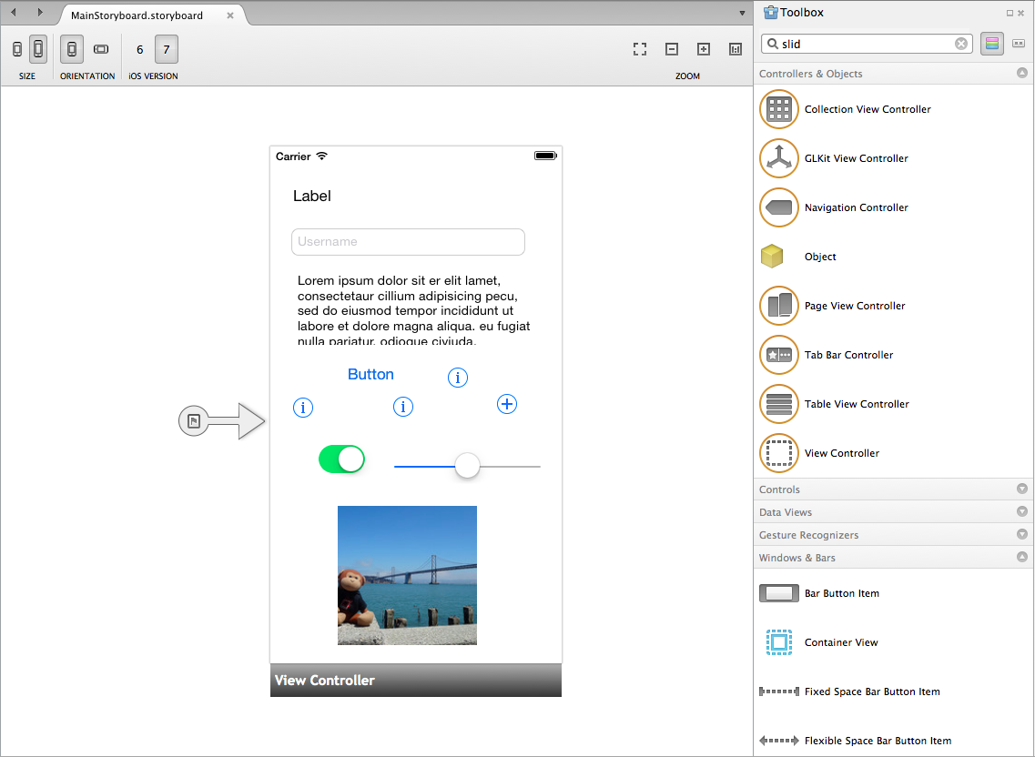
Xamarin iOS Designer
Notes:
Notes:
Build app UI using storyboards, scenes, and segues in Xamarin iOS Designer. This is the Xamarin option to the Xcode interface builder.
References:
Image courtesy of Xamarin: https://developer.xamarin.com/guides/ios/user_interface/controls/part_1_-_creating_user_interface_objects/Images/Image2b.png

Slide 19
iOS Layouts
Two approaches to iOS UI layout
AutoLayout uses constraints (Most common approach)
Frames use rectangles to bound the view
Notes:
Notes:
Views are added as subviews to UIView by using one of two techniques: AutoLayout and Frames. The
AutoLayout technique uses constraints to create relative horizontal and vertical relationships between
views. The Frames technique uses rectangles to bound the view, assigning them to the Frame property of the
view. Location and size are absolute when using Frames and relative when using AutoLayout.

Slide 20
AutoLayout
Most commonly with UIViews with AutoLayout
AutoLayout uses constraints
Frames use rectangles to bound the view
Notes:
Notes:
Views are added as subviews to UIView by using one of two techniques: AutoLayout and Frames. The
AutoLayout technique uses constraints to create relative horizontal and vertical relationships between
views. The Frames technique uses rectangles to bound the view, assigning them to the Frame property of the
view. Location and size are absolute when using Frames and relative when using AutoLayout.

Slide 21
Define a Control
//In the UIViewController:
public override void ViewDidLoad () {
base.ViewDidLoad ();
var textView = new UITextField {
Placeholder = "Your name",
BorderStyle = UITextBorderStyle.RoundedRect
}
};
Notes:
Notes:
In your UIViewController’s ViewDidLoad method, instantiate a text box by using UITextField. Then add size and location constraints to it before adding it to the parent view.

Slide 22
Add Constraints
textView.AddConstraints (new[] {
NSLayoutConstraint.Create (textView , NSLayoutAttribute.Height,
NSLayoutRelation.Equal, null, NSLayoutAttribute.NoAttribute,
1, 50),
NSLayoutConstraint.Create (textView , NSLayoutAttribute.Width,
NSLayoutRelation.Equal, null, NSLayoutAttribute.NoAttribute,
1, 200),
});
Add(textView);
View.AddConstraints (new[] {
//Location
NSLayoutConstraint.Create (textView, NSLayoutAttribute.Left,
NSLayoutRelation.Equal, View, NSLayoutAttribute.Left, 1, 10),
NSLayoutConstraint.Create (textView, NSLayoutAttribute.Top,
NSLayoutRelation.Equal, View, NSLayoutAttribute.Top, 1, 30)
});
Notes:
Notes:
Now we add constraints to the control and to the view. This is accomplished using the AddConstraints method of the control, which uses NSLayoutConstraint.
Using AddConstraints, specify the size of the text field. Build the constraints using the NSLayoutConstraint.Create method specifying the NSLayoutAttribute, in this case Height and Width. The Add method adds the textView control to the view.
Using View.AddConstraints, specify the location of the text field. Constrain the control to the top-level view by using the AddConstraints method on the View. NSLayoutAttribute.Left allows us to place the textView 10 points from the left, and NSLayoutAttribute.Top allows us to specify 30 points from the top.
References:
Image from Xamarin Mobile Application Development by Dan Hermes http://amzn.to/1rowG7K

Slide 23
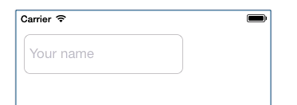
Basic Controls
UIButton
UILabel – read-only text
UITextView - editable text
UIImage
Notes:
Notes:
The image here is an example of UITextView

Slide 24
Define a Control
Two ways to define controls
Add controls to a UIView using a designer tool
Add control by coding in the UIViewController:
var button = UIButton.FromType(UIButtonType.System);
button.SetTitle (“Push Me", UIControlState.Normal);

Slide 25
Handling Events
There are three ways to handle events:
button.TouchUpInside += (object sender, EventArgs e) => {…}
button.TouchUpInside += delegate {…}
button.TouchUpInside += buttonClickHandler();
Notes:
Notes:
The three ways to handle control events remains the same across platforms.

Slide 26
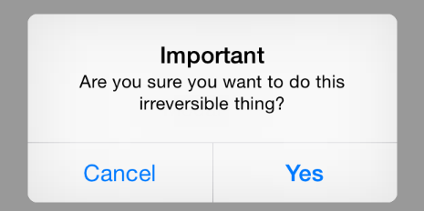
UIAlertController
Customizable modal dialog box
var alert = UIAlertController.Create("Important", "Are you sure you want to do this irreversible thing?",
UIAlertControllerStyle.Alert);
alert.AddAction(UIAlertAction.Create("Cancel", UIAlertActionStyle.Cancel, alertAction => {}));
alert.AddAction(UIAlertAction.Create("Yes", UIAlertActionStyle.Default, alertAction => {}));
this.PresentViewController(alert, true, null);
Notes:
Notes:
Alerts and user notifications are typically small modal pop-up dialog boxes containing real-time feedback to the user and one or more buttons to allow the user to dismiss or choose an option in response. Using UIAlertController, a title and message are included in the alert with the Create method, and buttons are added with the AddAction method.
References:
Images from Xamarin Mobile Application Development by Dan Hermes http://amzn.to/1rowG7K

Slide 27
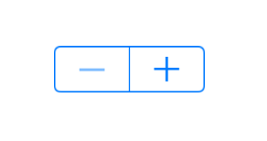
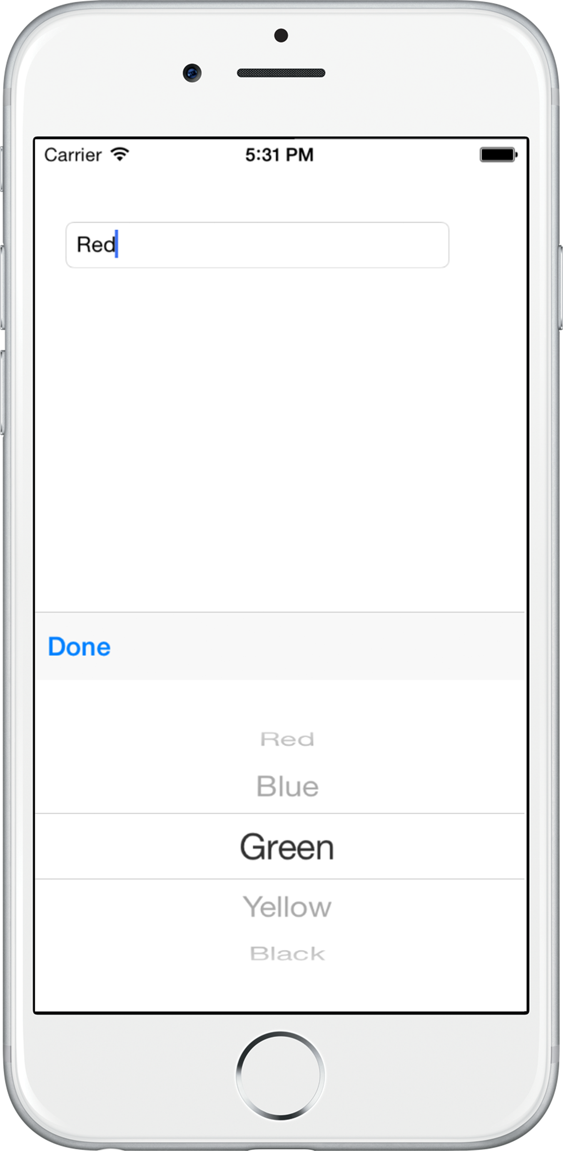
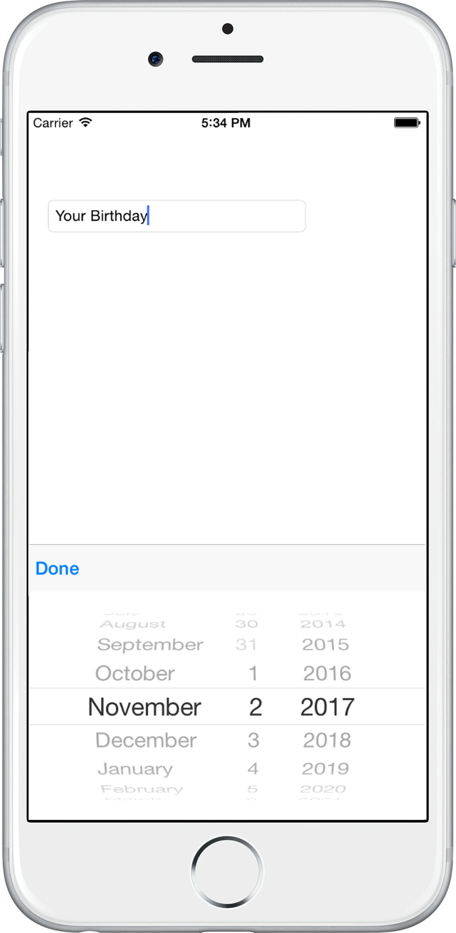

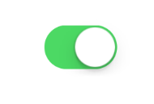
Selection Controls
UIStepper UIPickerView UIDatePicker
UISlider
UISwitch
Notes:
Notes:
Some of most common iOS selection controls are UIPickerView, UIDatePicker, UIStepper, UISlider, and UISwitch. UIPickerView supplies a drop-down list, UIStepper gives a plus/minus button for changing numeric values, and the rest are self-explanatory.
Similar to Android, iOS controls don’t produce a modal dialog box by default, but produce only an inline dialog. Use the UITextField.InputView modal dialog technique.
References:
Images from Xamarin Mobile Application Development by Dan Hermes http://amzn.to/1rowG7K

Slide 28
Lists in Xamarin.iOS Using UITableView

Slide 29
iOS UITableView
UITableView is a flexible, all-purpose list-building class
Instantiate a UITableView
Create an adapter subclassed from UITableViewSource
Assign the adapter instance to the UITableView.Source property
Use a data source, such as an array or data model
Notes:
Notes:
Lists in iOS are created using the UITableView control bound to an array or a data model. UITableView provides groupings, headers, footers, images, and indexes. Each list requires a UITableView for the view, an adapter subclassed from UITableViewSource and assigned to the UITableView.Source property, and a data source, such as an array or data model.

Slide 30
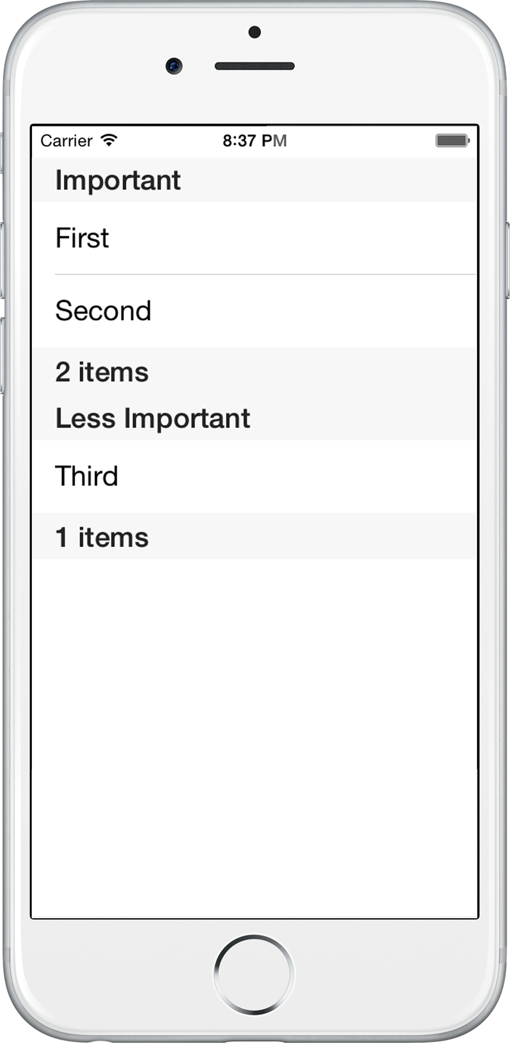
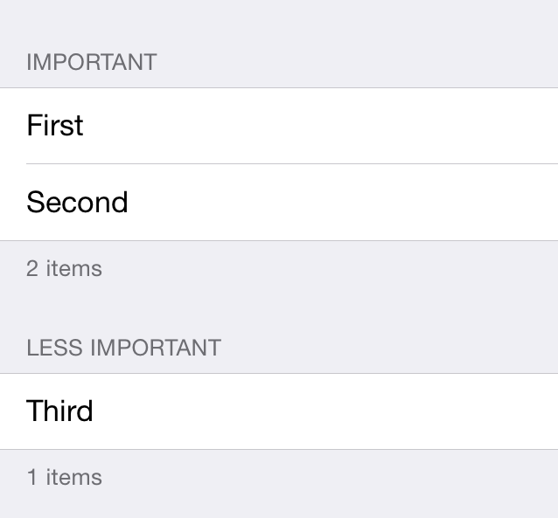
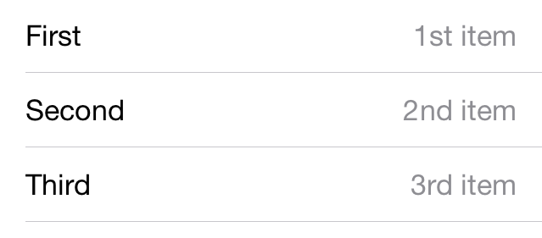
UITableViews
Notes:
References:
Images from Xamarin Mobile Application Development by Dan Hermes http://amzn.to/1rowG7K

Slide 31
UITableView and Data Model
public override void ViewDidLoad()
{
base.ViewDidLoad();
UITableView table = new UITableView(View.Bounds);
string[] tableItems = new string[] {"First","Second","Third","Fourth","Fifth"};
table.Source = new ListSource(tableItems);
Add (table);
}
Notes:
Notes:
Create a new file of type iPhone View Controller called ListArrayViewController.cs. In this file, instantiate UITableView and add it to a view in the ViewDidLoad method of the ViewController.
Populate the data source. In the ViewController’s ViewDidLoad method, create an array of strings and pass it into the constructor for ListSource, and assign the new adapter to the Source property on the table. This binds the array to the UITableView. Add the completed table to your ViewController
Then create an adapter…

Slide 32
UITableViewSource
public class ListSource : UITableViewSource
{
protected string[] listItems;
protected string CellId= "TableCell";
public ListSourceFromArray(string[] items)
{
listItems = items;
}
public override nint RowsInSection (UITableView tableview, nint section)
{
return listItems.Length;
}
public override UITableViewCell GetCell (UITableView tableView, NSIndexPath indexPath)
{
UITableViewCell cell = tableView.DequeueReusableCell (CellId);
if (cell == null) cell = new UITableViewCell (UITableViewCellStyle.Default, CellId);
cell.TextLabel.Text = listItems[indexPath.Row];
return cell;
}
}
Notes:
Notes:
For the adapter, create a new empty class called ListSourceFromArray.cs, subclass it from UITableViewSource, create a constructor, and override the RowsInSection and GetCell methods. Create an array of strings called listItems to bind to the list’s TextLabel.Text property. The RowsInSection method returns the length of the entire list, as shown in Listing 5-19.
Cell reuse in GetCell improves performance, thereby making scrolling faster with fewer skipped frames. As each row is retrieved, the DequeueReusableCell method checks to see if a cell (memory location for a row) already exists for that CellId. If it comes back null then instantiate a new cell, otherwise use it. When a list is scrolled, this method is called to create more rows to display on the screen, recycling cells when possible. Type NSIndexPath comes from the Foundation library in the using.

Slide 33
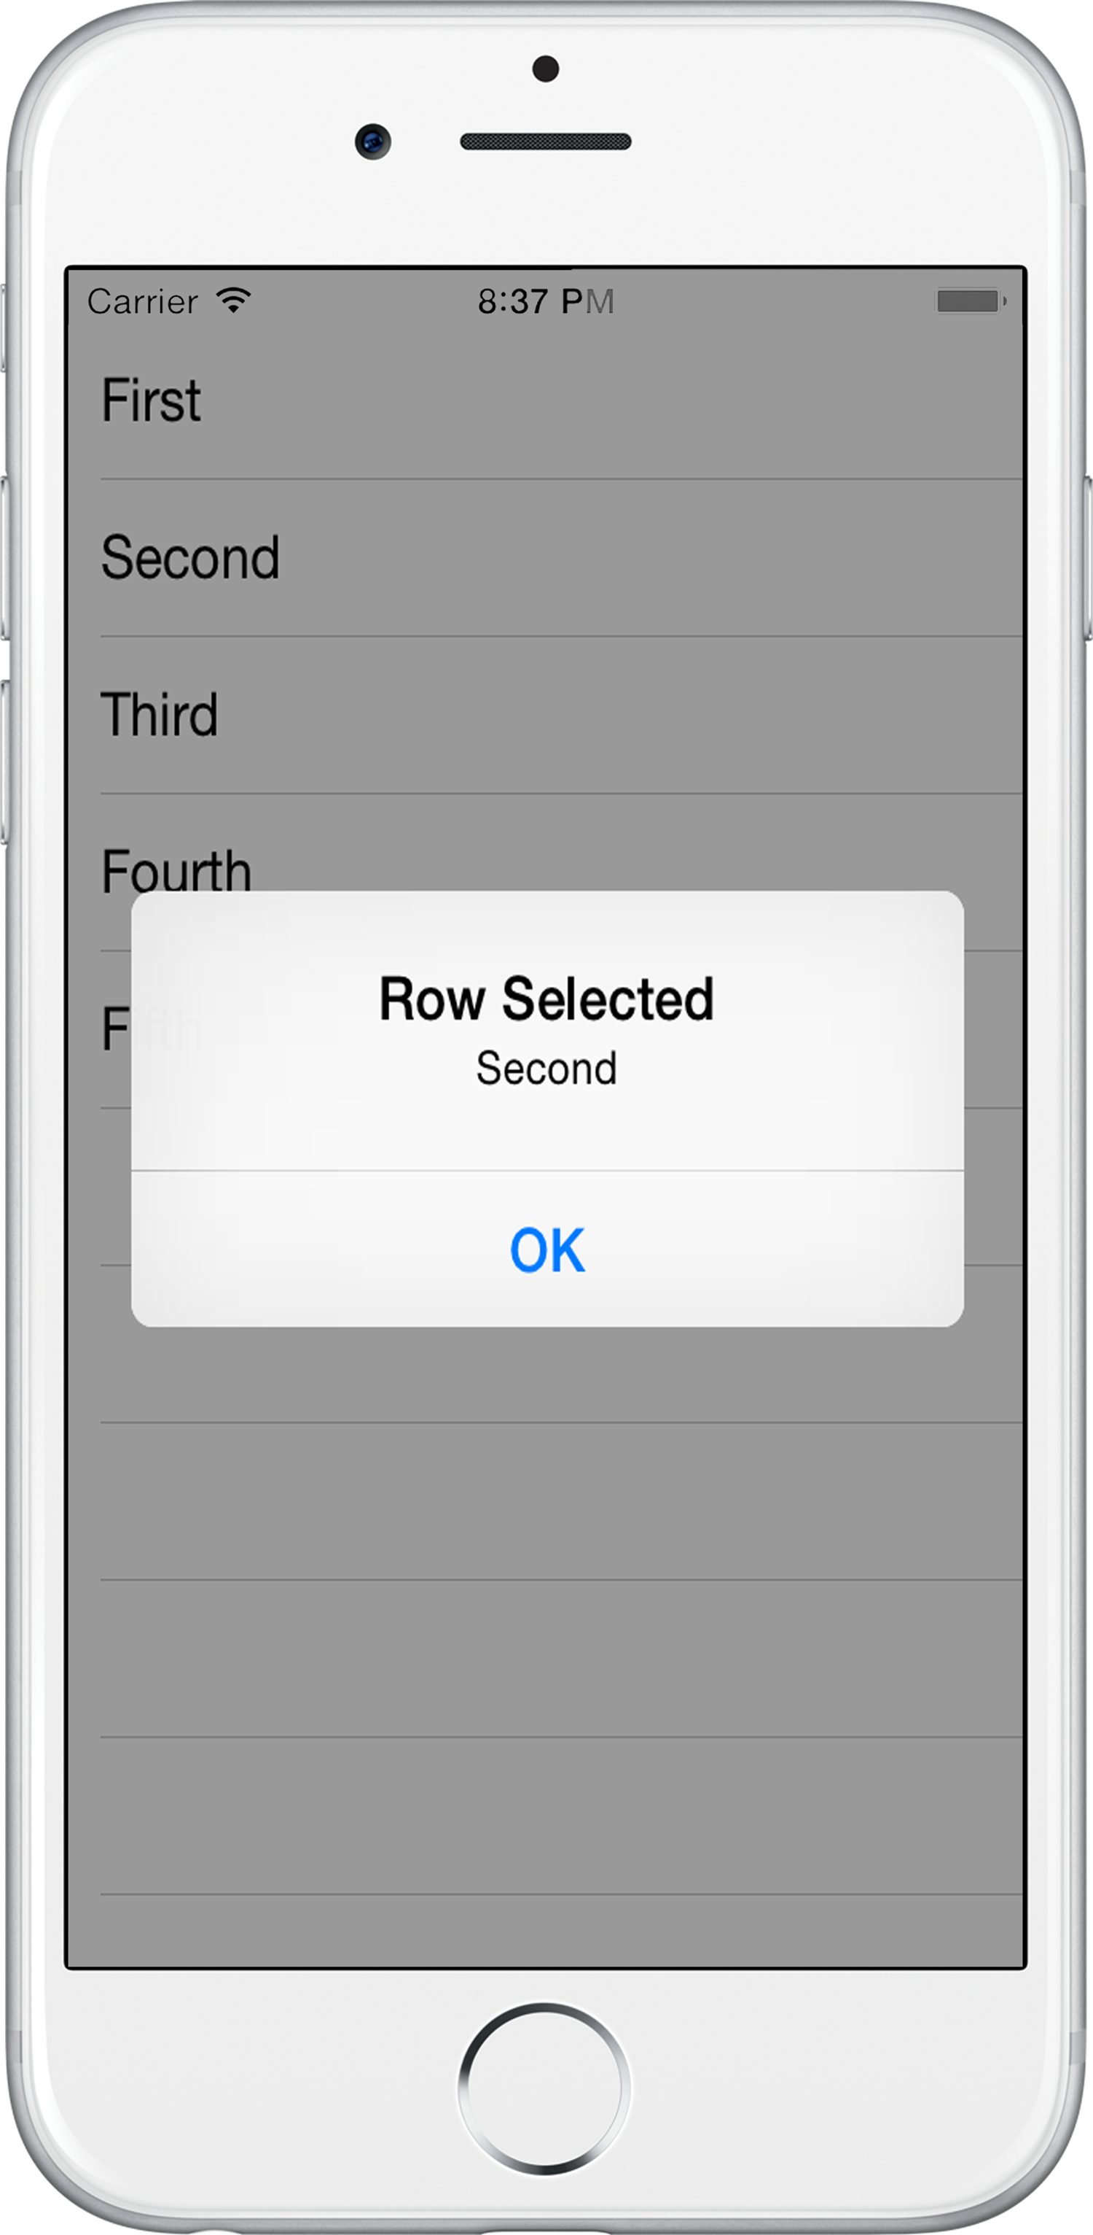
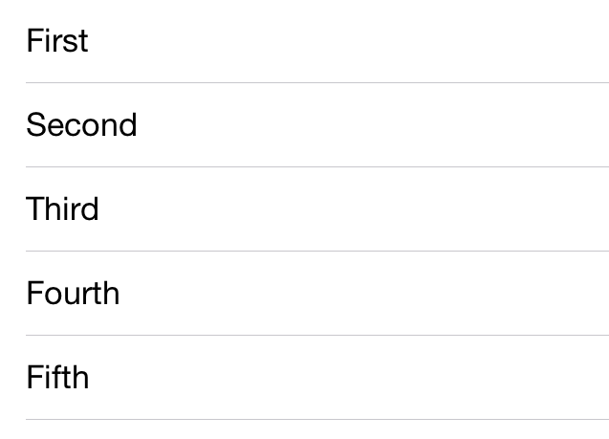
UITableView Result
Notes:
Notes:
Result of previous code.
References:
Images from Xamarin Mobile Application Development by Dan Hermes http://amzn.to/1rowG7K

Slide 34
UITableView Selection
Override the RowSelected event in the UITableViewSource subclass
public override void RowSelected (UITableView tableView, NSIndexPath indexPath)
{
new UIAlertView("Row Selected", listItems [indexPath.Row], null, "OK", null).Show();
tableView.DeselectRow (indexPath, true);
}
Notes:
Notes:
Selection of a list item is handled by overriding the RowSelected event in the UITableViewSource subclass. indexPath denotes the index of the row. DeselectRow removes the highlight from the selected row.
References:
Images from Xamarin Mobile Application Development by Dan Hermes http://amzn.to/1rowG7K

Slide 35
Summary
In this lesson, you have learned:
How Xamarin code builds an iOS application
Basic iOS development concepts
User interfaces on the iOS platform
Notes:
Notes:
The Module 3 Lesson 6 Lab should be completed at this time:
https://github.com/MSFTImagine/computerscience/tree/master/Complimentary%20Course%20Content/Module3/Labs

